Slide 1
So I DevSecOpsed Office 365
@alexmags #winops

Slide 2

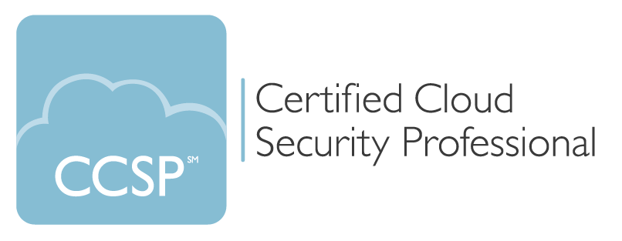

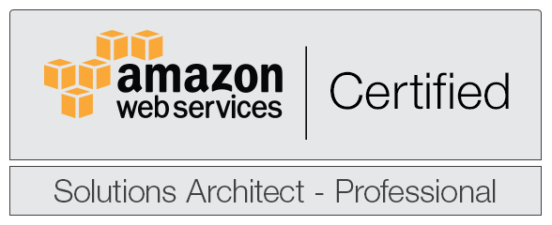
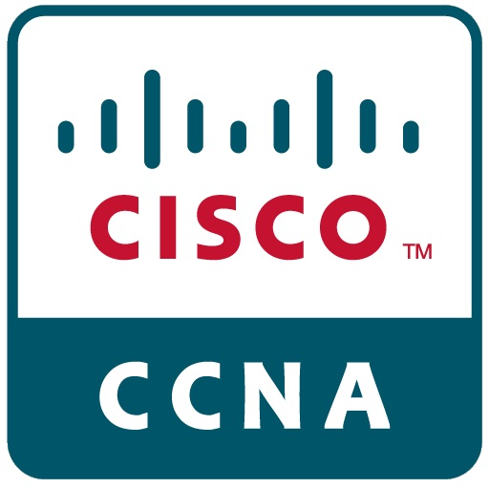
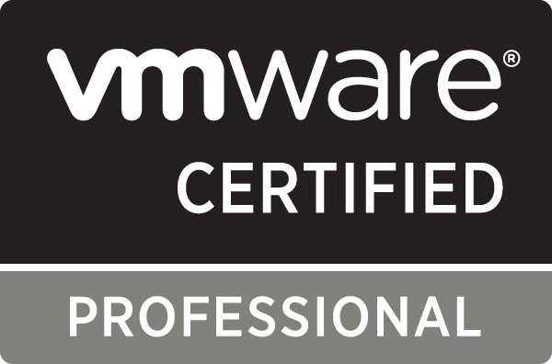

Alex Magnay
Twitter: @alexmags
Email: alex@alexmags.com
linkedin.com/in/amagnay
Notes:
Background infrastructure engineering teams investment banking, asset management
High availability, high security, regulatory compliance.
Come off Office365 deployment. Sprinked DevOps on it

Slide 3
This talk
Unconventional use of Release Pipelines
Office 365 configuration as versioned code
Releasing changes through environments to prod
Testing Office 365 configuration compliance
NIST CyberSecurity Framework

Slide 4
So much to configure!!!
AAD tenant config
AAD Privliged Identity Management
AAD Conditional Access
Office 365 Groups policies
Exchange spam policies
Exchange anti phish policies
Exchange Malware filter policy
Exchange safe attachments policies
Exchange safe links policies
Exchange org config
Exchange Authentication policies
Exchange DKIM and antispoofing
Exchange role-based access
Exchange Transport Rules
Exchange connector TLS policies
Exchange Data loss prevention policies
Sensitive information types
Office 365 audit log alerts
Data Retention policies
SharePoint tenant config
SharePoint DLP policies
SharePoint role-based access
Teams messaging policies
Teams meeting policies
Teams client policies
Teams federation
Teams role-based access
Etc….
Etc….
Etc….
Notes:
All the configuration needs to be tracked, maintained

Slide 5

Notes:
Office365 Security Portal

Slide 6
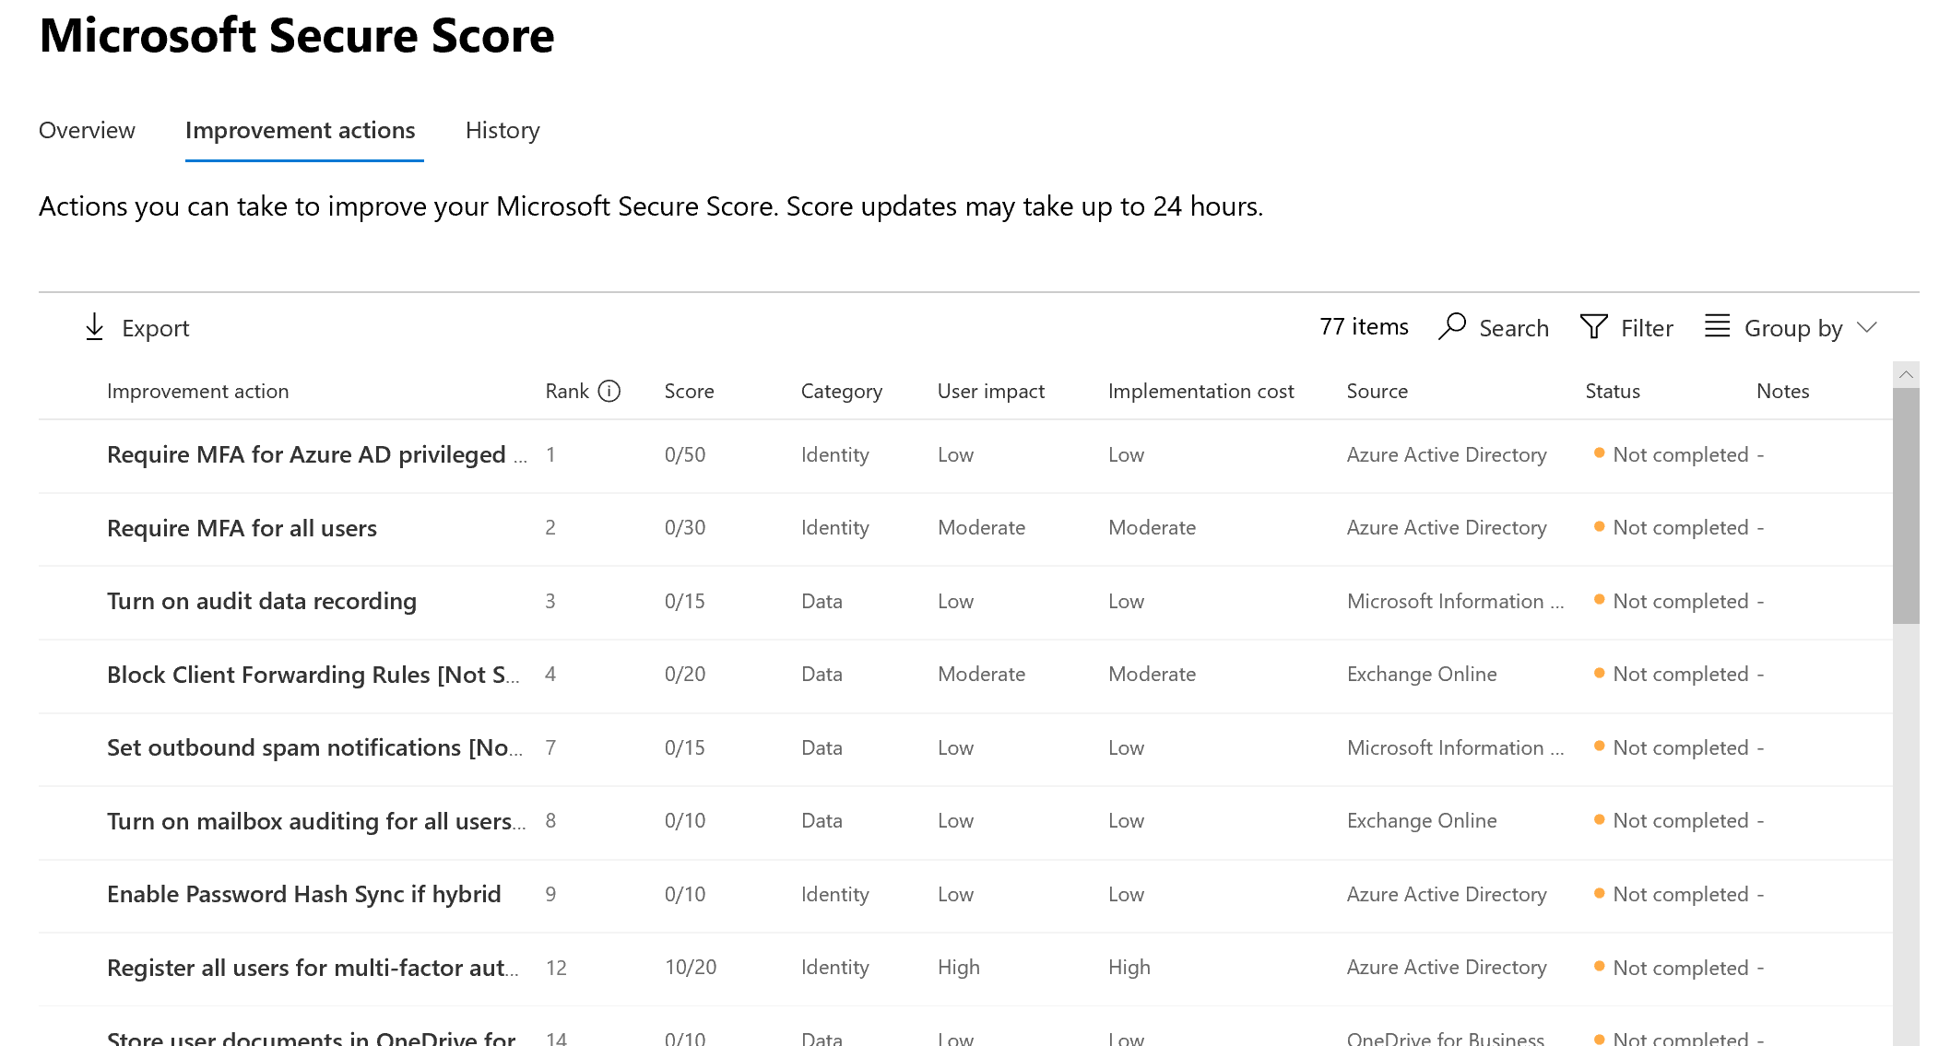
What’s included?
Notes:
Graph API you can export this list of improvement actions and see if any flipped from completed to not completed?

Slide 7
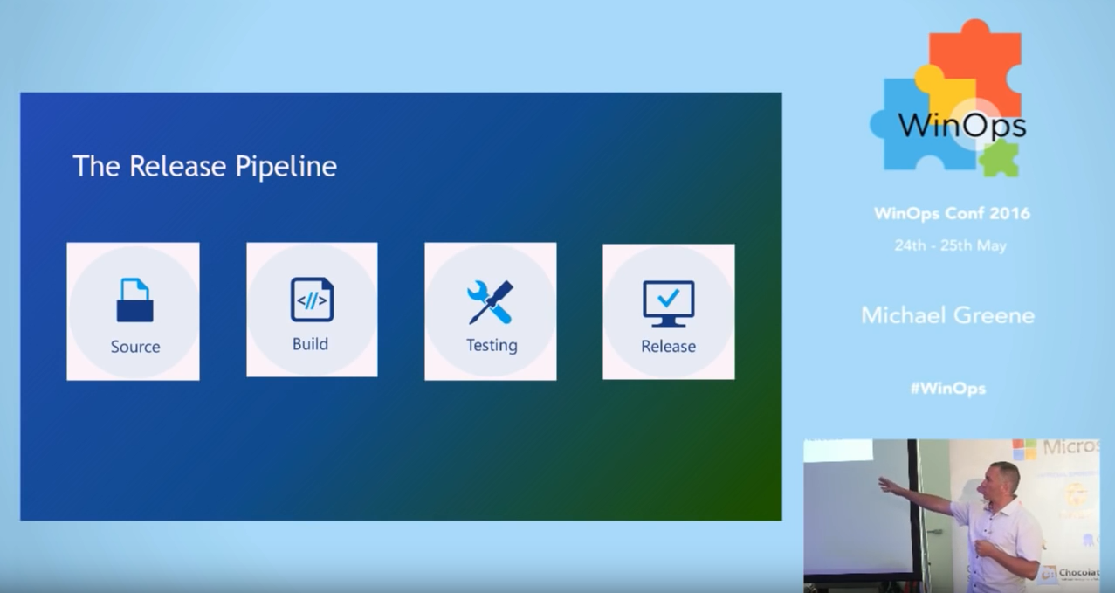
https://www.youtube.com/watch?v=6mFk3Oxdiwc
Notes:
Most accessible intro to release pipelines. Esp OPS guys

Slide 8
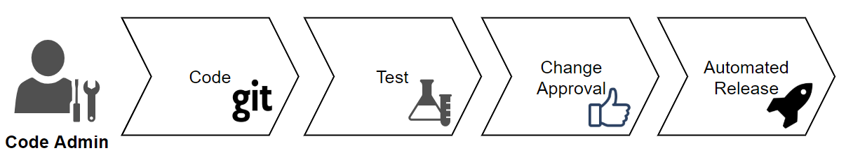

Slide 9
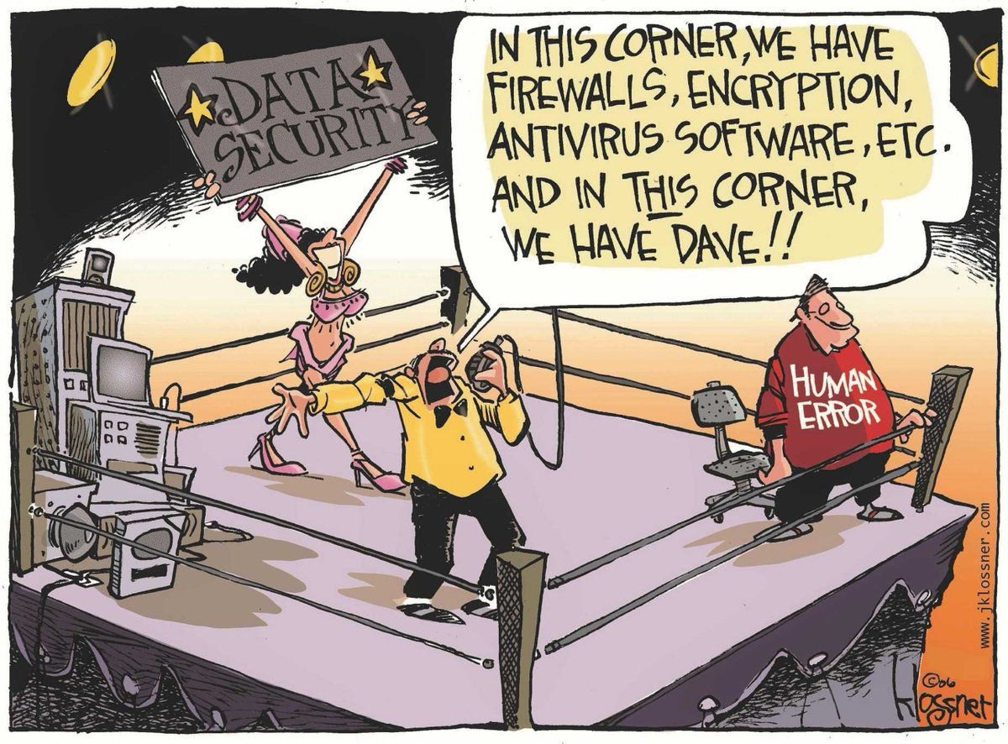
Notes:
When you’ve been configuring Conditional Access by hand, and locked yourself and the entire company out, you know it.
http://www.jklossner.com/humannature

Slide 10
Environments & Licensing

Slide 11
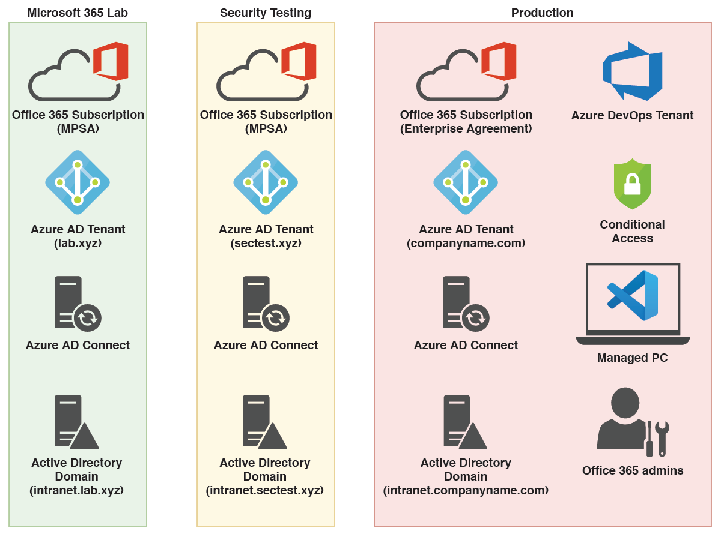
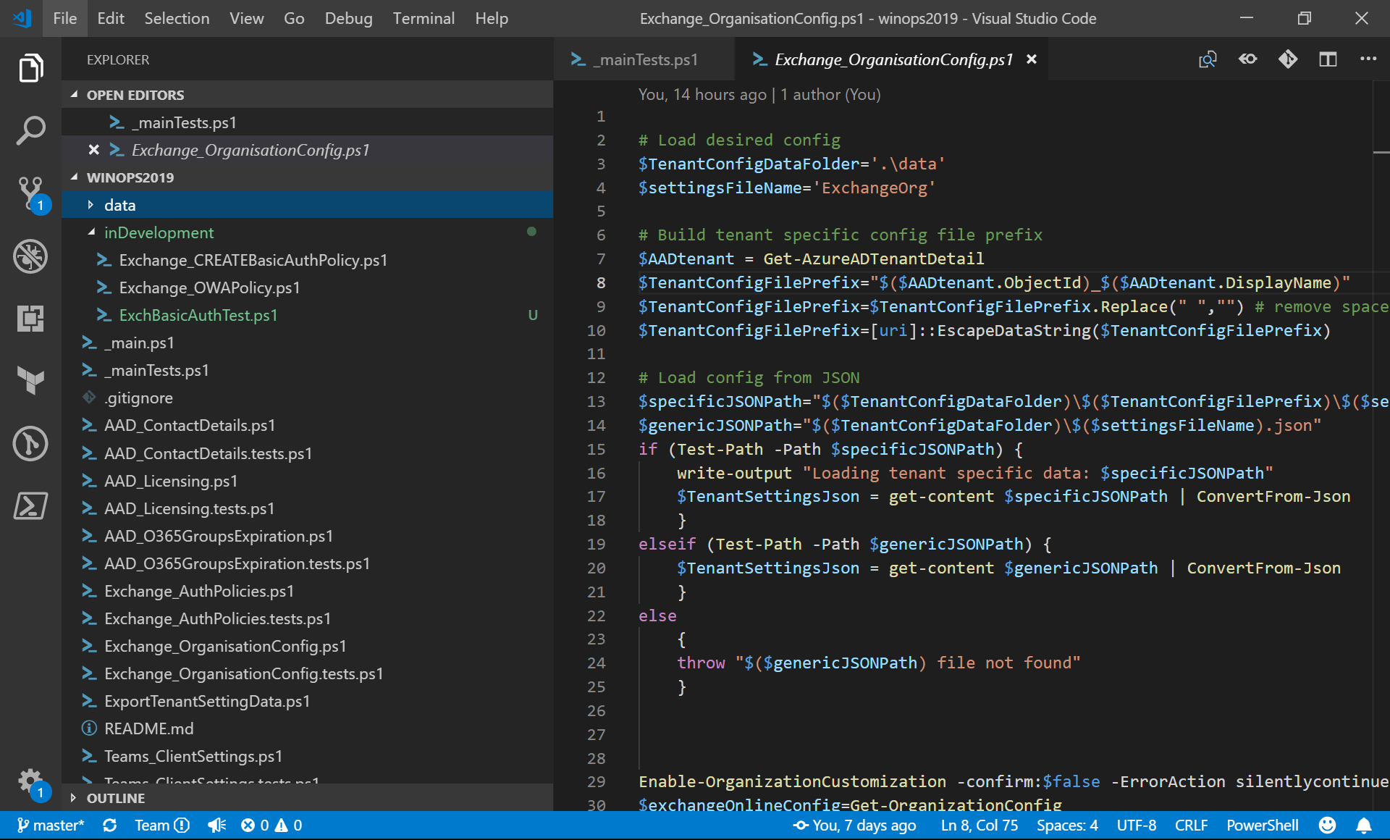
Notes:
EA (250 users minimum)
MPSA (points, # users vary on E3 or E5)

Slide 12
Enterprise Agreement
Fabricam
IT
Research
Contoso
IT
EA Portal
Departments
Accounts
Azure Subscriptions
Production
Grid
Lab
Test
Production

Slide 13
Enterprise Agreement
Fabricam
IT
Research
Contoso
IT
EA Portal
Invoicing
Accounts
Subscriptions
Production
Grid
Azure Lab
Test domain
Production domain
AAD Identity
Lab domain
Azure Test
Azure Prod
O365 Lab
(MPSA)
O365 Test (MPSA)
O365 Production
Azure DevOps
Notes:
LOGICALLY

Slide 14
Configuration as code

Slide 15
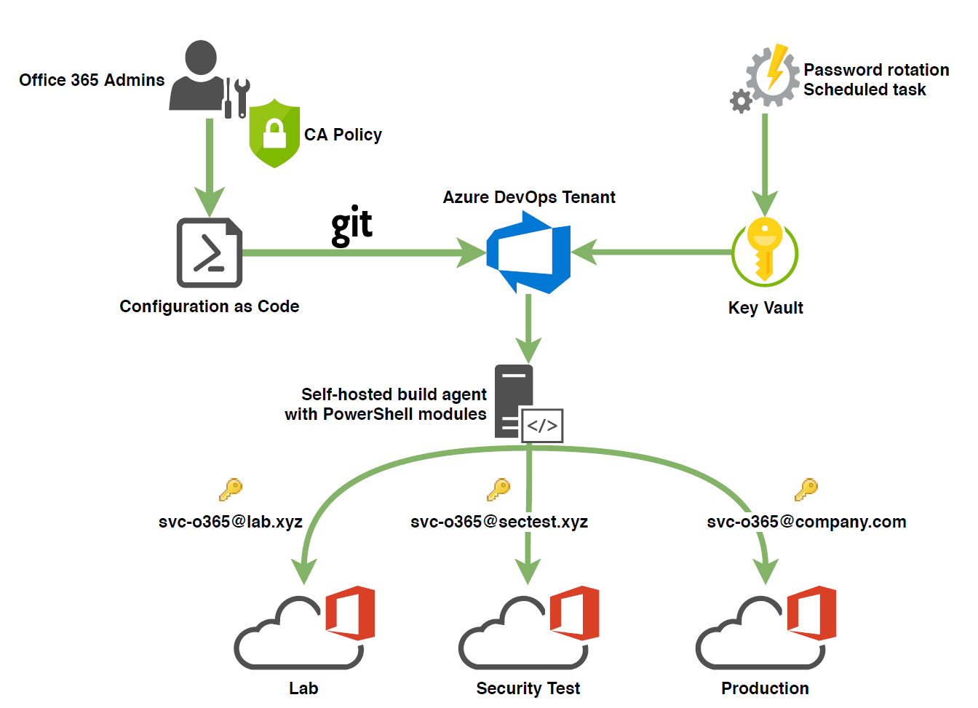
Notes:
The account provided gives the code context
Used Onmicrosoft.com

Slide 16
Compliance as code

Slide 17
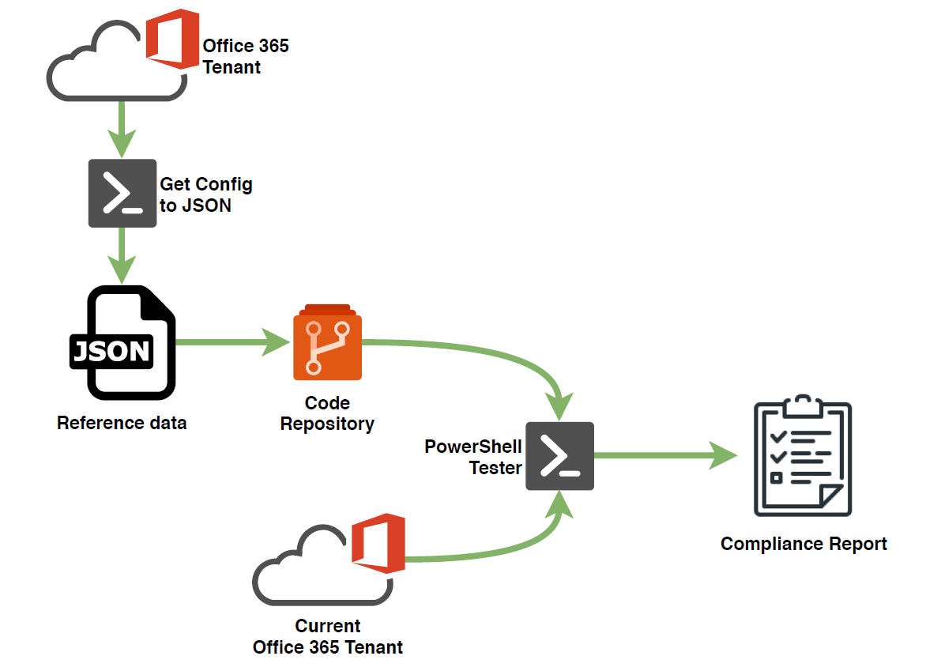

Slide 18

The demo part

Slide 19
Lab tenant config exported to JSON
# Export Exchange auth policies
Get-AuthenticationPolicy `
| ConvertTo-Json -Depth 10 `
| Out-File "ExchangeAuthenticationPolicies.json"

Slide 20
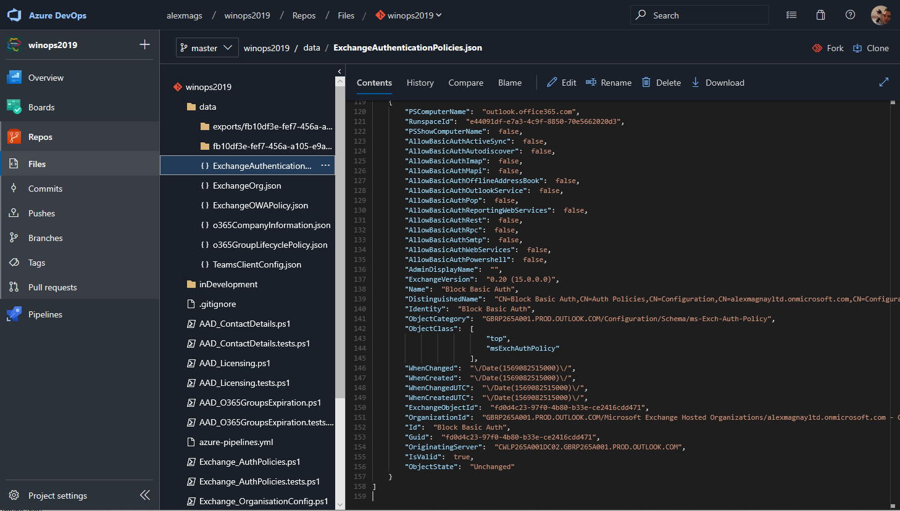
Notes:
Config exported to JSON

Slide 21
Read tenant config and set stuff
$TenantSettingsJson = get-content 'ExchangeAuthenticationPolicies.json' | ConvertFrom-Json
Foreach ($policy in $TenantSettingsJson)
{
Write-Output "Applying Exchange authentication policies for: $($policy.identity)"
# build hashtable of switches for PowerShell splatting
$HashArguments = @{
AllowBasicAuthActiveSync = $policy.AllowBasicAuthActiveSync
AllowBasicAuthAutodiscover =$policy.AllowBasicAuthAutodiscover
AllowBasicAuthImap = $policy.AllowBasicAuthImap
AllowBasicAuthMapi = $policy.AllowBasicAuthMapi
AllowBasicAuthOfflineAddressBook = $policy.AllowBasicAuthOfflineAddressBook
AllowBasicAuthOutlookService = $policy.AllowBasicAuthOutlookService
AllowBasicAuthPop = $policy.AllowBasicAuthPop
AllowBasicAuthReportingWebServices = $policy.AllowBasicAuthReportingWebServices
AllowBasicAuthRpc =$policy.AllowBasicAuthRpc
AllowBasicAuthSmtp = $policy.AllowBasicAuthSmtp
AllowBasicAuthWebServices = $policy.AllowBasicAuthWebServices
AllowBasicAuthPowershell = $policy.AllowBasicAuthPowershell
}
# Test if policy if exists and update it. Otherwise create new policy
If (Get-AuthenticationPolicy -Identity $policy.name -ErrorAction SilentlyContinue)
{
Set-AuthenticationPolicy -Identity $policy.name @HashArguments -Verbose
}
else # create new policy
{
New-AuthenticationPolicy -name $policy.Name @HashArguments -Verbose
}
}
1. Create object from JSON
2. Loop though policies in JSON object
3. Build hash table of command switches based on object properties
4a. Execute set command with switches
or
4b. Execute new command with switches

Slide 22
Testing with Pester
Describe 'Notepad’ {
It 'Exists in Windows folder’ {
'C:\Windows\notepad.exe' | Should -Exist
}
}
Describing Notepad
[+] Exists in Windows folder 4ms
https://github.com/pester
Notes:
Assert things that should be true and you want to know if they’re not

Slide 23
Testing with Pester
Describe 'Notepad’ {
It 'Exists in Windows folder’ {
'C:\Windows\NotAtAllPad.exe' | Should -Exist `
-because "law 57 of Windows builds"
}
}
Describing Notepad
[-] Exists in Windows folder 17ms
Expected path 'C:\Windows\NotAtAllPad.exe' to exist,
because law 57 of Windows builds, but it did not exist.
https://github.com/pester
Notes:
Use –because Pester v4

Slide 24
Test tenant config compared to JSON
$TenantSettingsJson = get-content $genericJSONPath | ConvertFrom-Json
$currentCompanyConfig = Get-AzureADMSGroupLifecyclePolicy -ErrorAction SilentlyContinue
# Note "-because" parameters requires Pester module v4
Describe "Office365 group lifecycle policy for $($AADtenant.DisplayName)" {
it "Office 365 group lifecycle policy" {
$currentCompanyConfig | should -not -BeNullOrEmpty `
-Because "Office 365 group lifecycle policy ensures projects are closed down and data archived"
}
it "Office 365 Group lifetime" {
$currentCompanyConfig.GroupLifetimeInDays | should -be $TenantSettingsJson.GroupLifetimeInDays `
-Because "Unused o365 groups should be archived after $($TenantSettingsJson.GroupLifetimeInDays)"
}
it "Office 365 group notification mails" {
$currentCompanyConfig.AlternateNotificationEmails | should -be $TenantSettingsJson.AlternateNotificationEmails `
-Because "$($TenantSettingsJson.AlternateNotificationEmails) should be notified of unused o365 groups"
}
}
Read JSON, get current config
Assert that current config shouldn’t be blank/unset
Assert that current config should match JSON

Slide 25
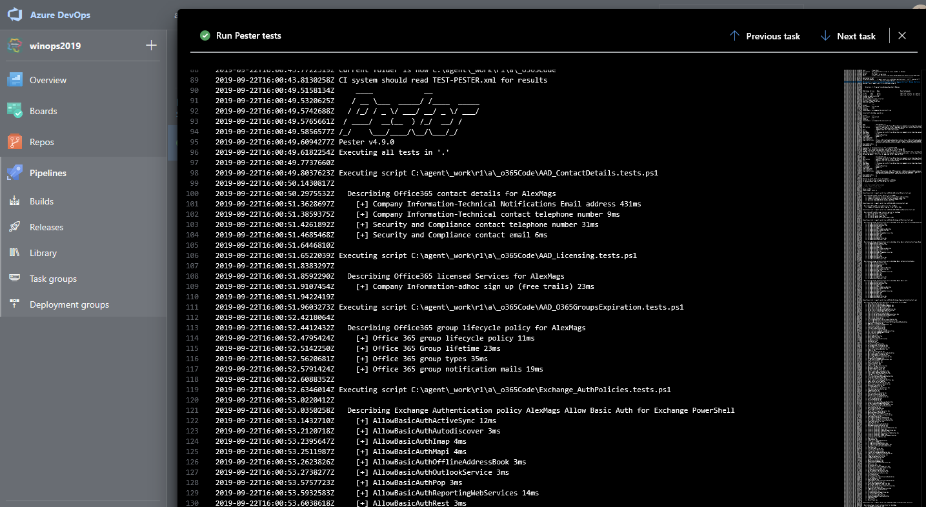
Notes:
Test current config compared to JSON

Slide 26
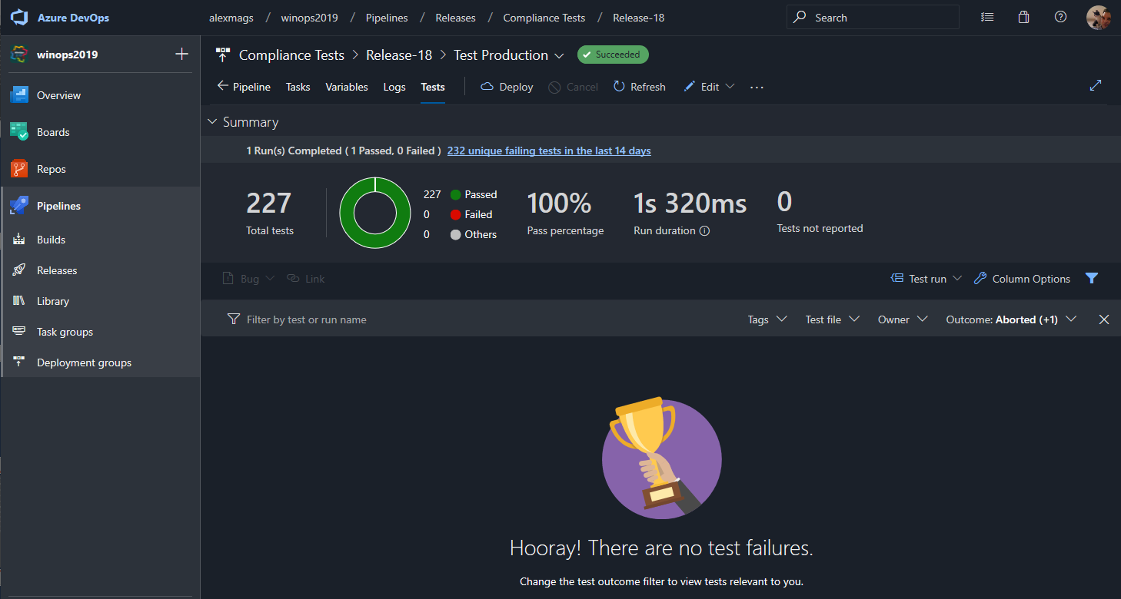

Slide 27
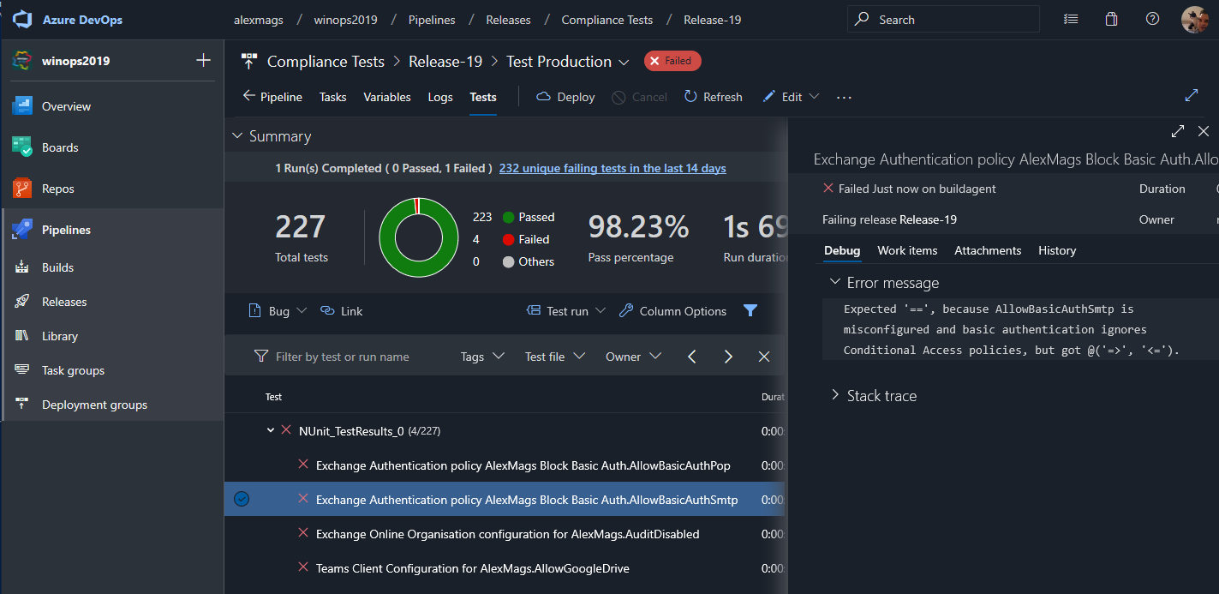

Slide 28
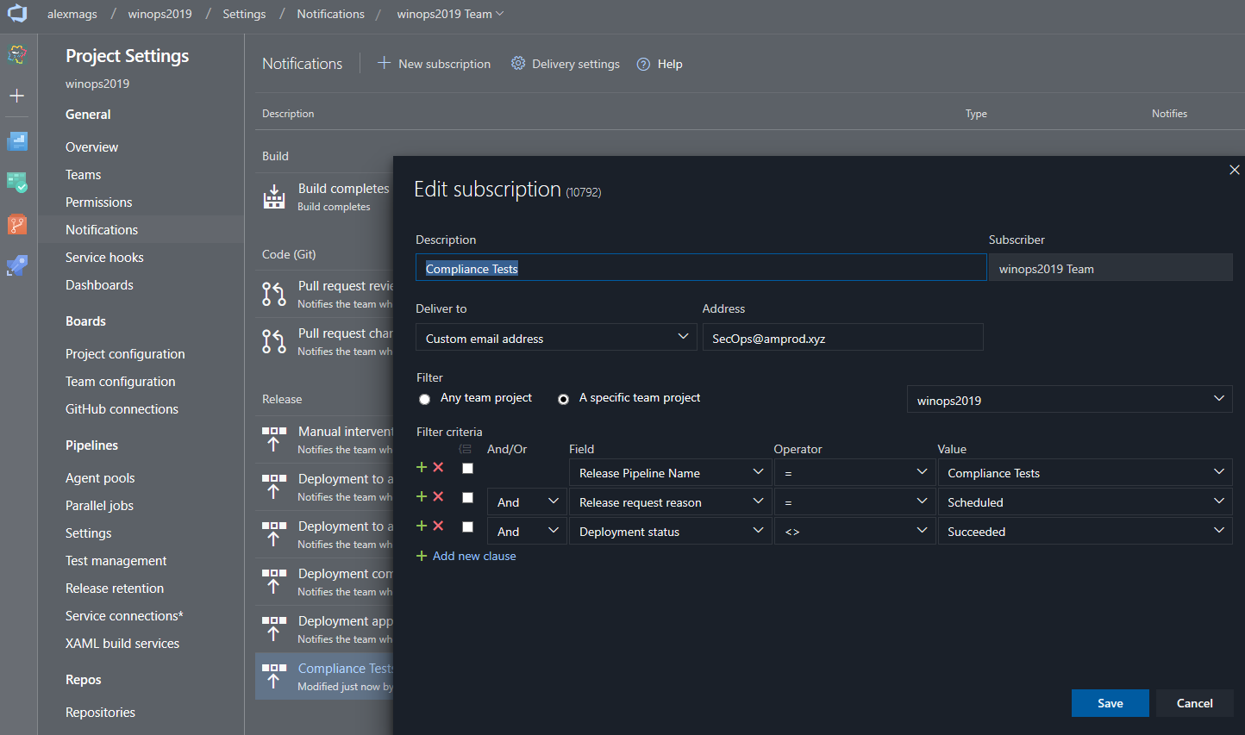
Notes:
Sent notifications to secops if compliance test fails

Slide 29
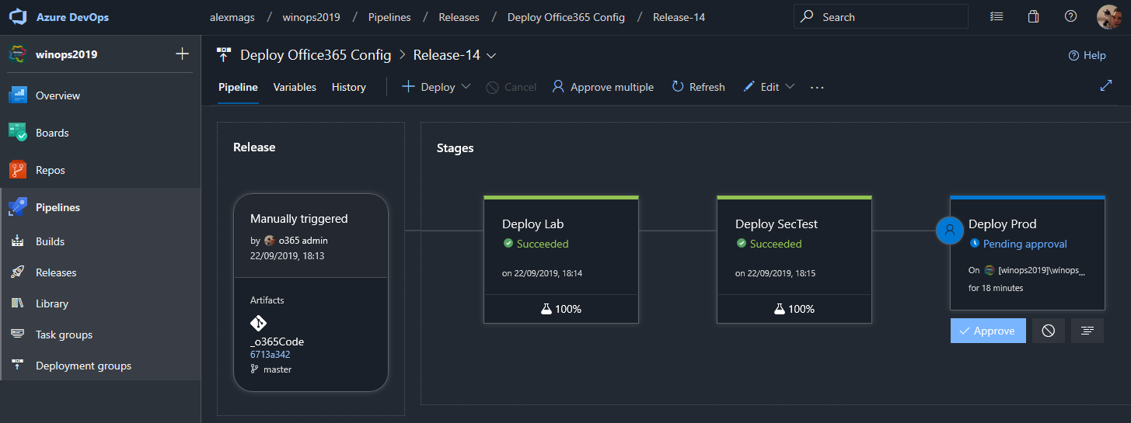
Release config to environments
Notes:
Additional approval required to deploy prod

Slide 30
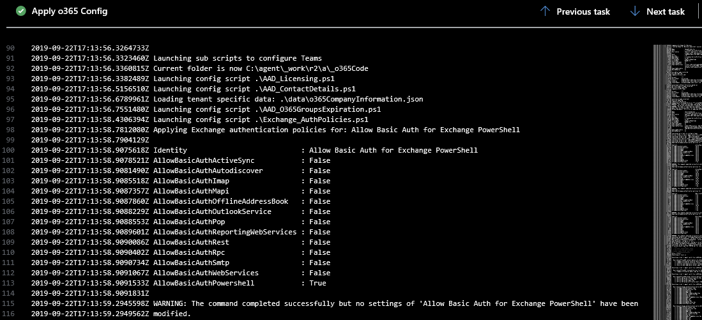
Log messages are captured
Notes:
It’s all audited

Slide 31
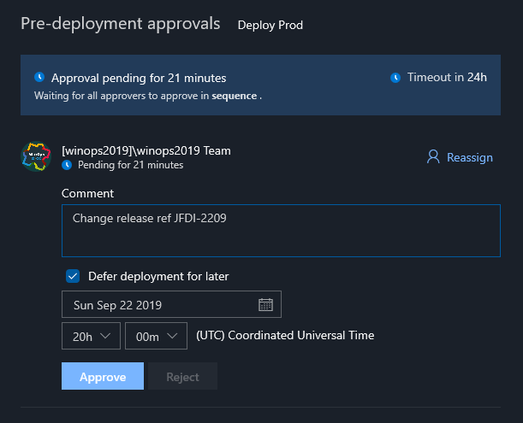
Release approvals
Approvals to individual or team
Approve & defer to change time
Approval Policies
Can’t approve own releases
Require additional MFA check
Release gates
Check ServiceNow change approval

Slide 32
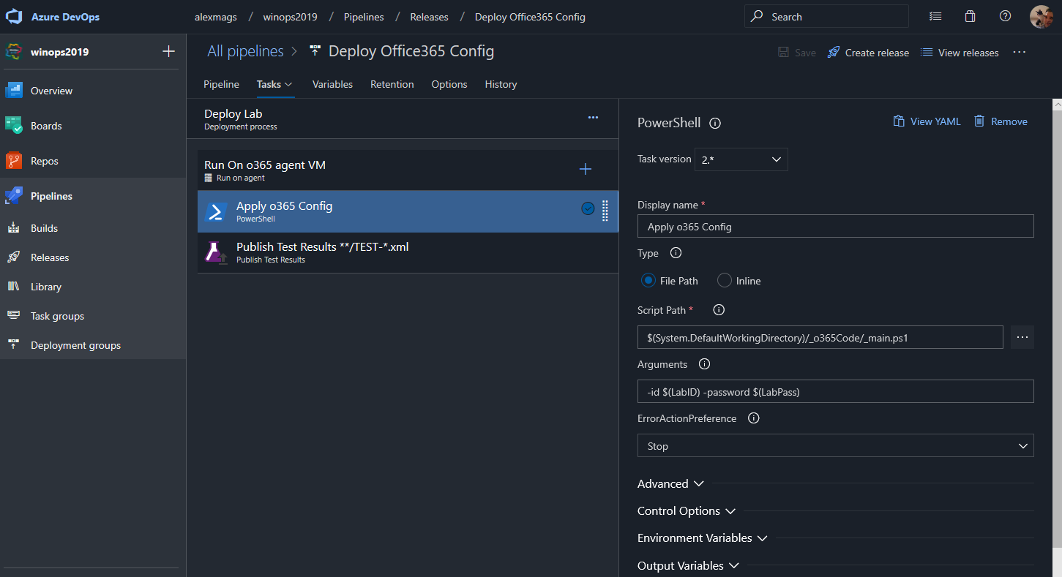
Notes:
Creds from variables. Code runs in tenant of ID. Azure devOps can use Azure Key Vault easily (see ms docs)

Slide 33
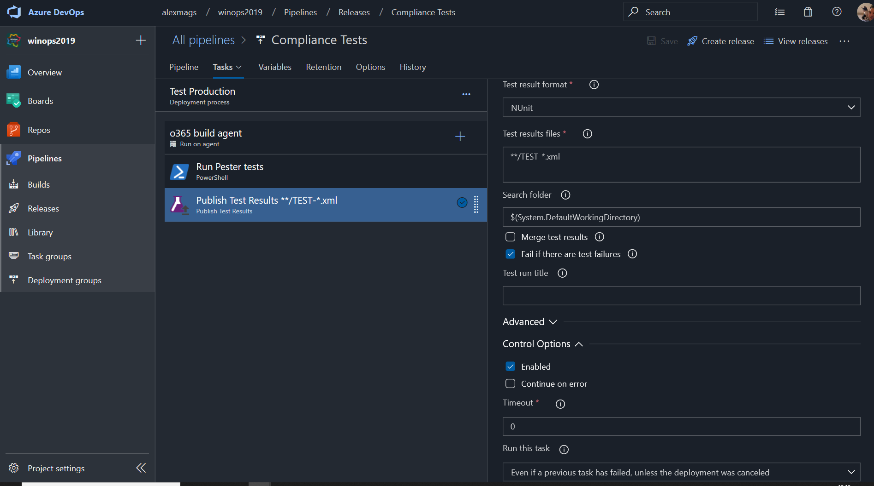

Slide 34
End of the demo part

Slide 35
So much to configure!!!
AAD tenant config
AAD Privliged Identity Management
AAD Conditional Access
Office 365 Groups policies
Exchange spam policies
Exchange anti phish policies
Exchange Malware filter policy
Exchange safe attachments policies
Exchange safe links policies
Exchange org config
Exchange Authentication policies
Exchange DKIM and antispoofing
Exchange role-based access
Exchange Transport Rules
Exchange connector TLS policies
Exchange Data loss prevention policies
Sensitive information types
Office 365 audit log alerts
Data Retention policies
SharePoint tenant config
SharePoint DLP policies
SharePoint role-based access
Teams messaging policies
Teams meeting policies
Teams client policies
Teams federation
Teams role-based access
Etc….
Etc….
Etc….
Notes:
Went to Security to ask how they want stuff set

Slide 36
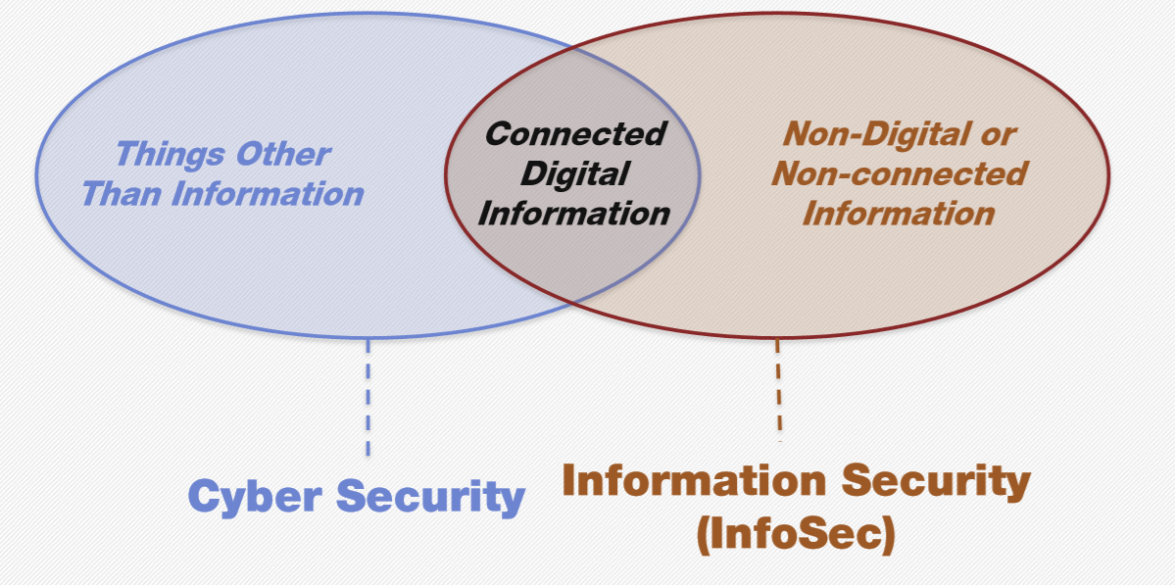
Security Teams you’ll meet
edX CYBER 503x Cybersecurity Risk Management | Tong Sun
Notes:
Big corp has multiple sec teams. Know how to talk to each of them

Slide 37
“you build it, we’ll review it”
Notes:
This was going nowhere.. How do you know when you’re done?

Slide 38
Categorise system and data
Select controls to reduce risk
Implement controls
Assess controls
Authorise. Risk is acceptable
Monitor
Risk Management Framework
https://nvlpubs.nist.gov/nistpubs/SpecialPublications/NIST.SP.800-37r2.pdf
Notes:
Continuous cycle of negociation with info sec. What you plan to do, scoped to what departments, what data they use.

Slide 39
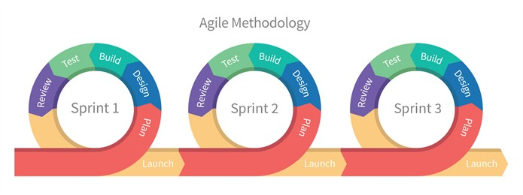
Product Release roadmap
Notes:
This cycle is sprintable. Incremental releases every sprint

Slide 40
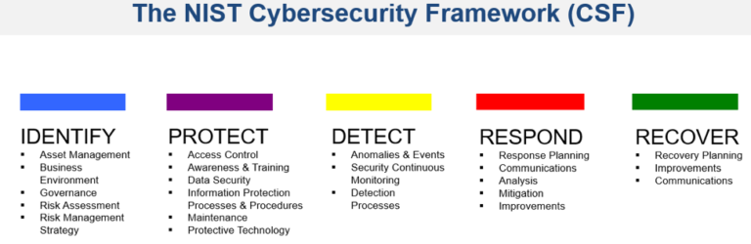
NIST CyberSecurity Framework
Notes:
CSF!!!

Slide 41
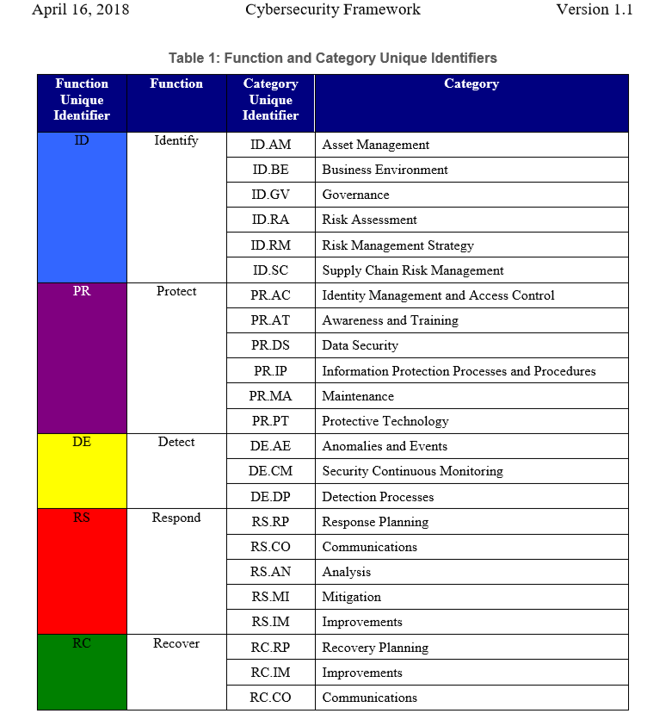
NIST CyberSecurity Framework
Identify - who/what you’re protecting
Protect - the data/system
Detect - problems
Respond– know who to tell, what to do
Recover – have a plan
https://www.nist.gov/cyberframework
Notes:
Secret weapon number 3. Check all your bases are covered (what you mean no one is looking at the audit logs…)

Slide 42
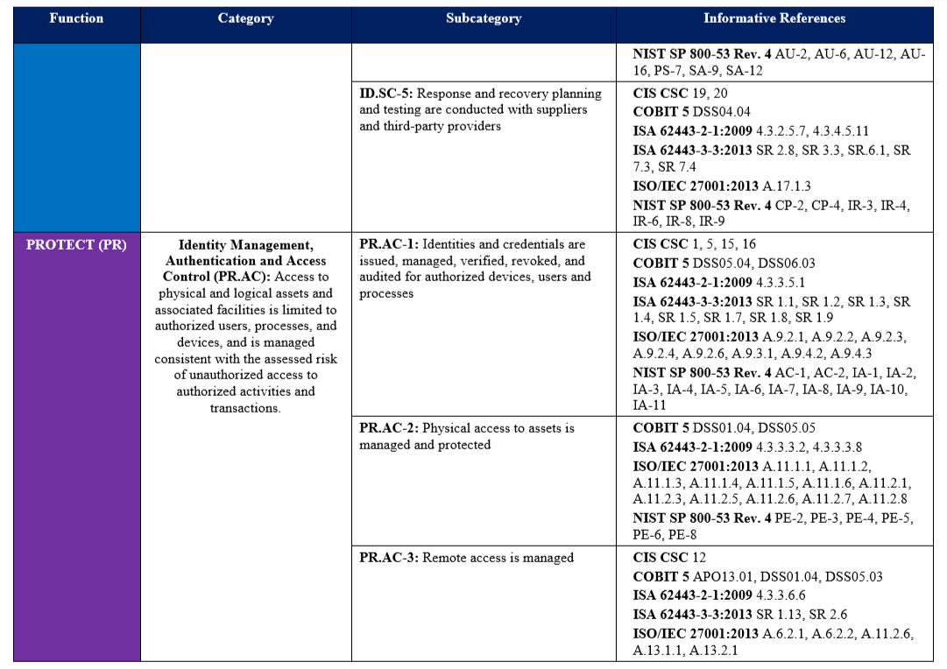
https://www.nist.gov/cyberframework

Slide 43
Describe your risks
Design your controls to make your risks less likely or lower impact

Slide 44
Example
Notes:
Risk – whats the bad thing that could happen Control – what makes it unlikely or lower impact
Work items – well defined so people can crack on
Talk with infosec, which risks and controls will get you to next stage on your roadmap?

Slide 45
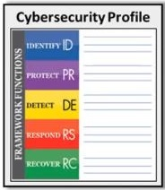
Completed controls reduce risk
Sprint1
PR.AC MFA PR.AC Rotate keys
Sprint2
PR.AC RBAC PR.IP Block internet
Sprint3
PR.AC AAD PIM PR.IP Azure firewall PR.PR Defender ATP PR.MA Auto update
Notes:
Controls == safe guards == countermeasures

Slide 46
Completed controls reduce risk
Sprint1
PR.AC MFA PR.AC Rotate keys
Sprint2
PR.AC RBAC PR.IP Block internet
Sprint3
PR.AC AAD PIM PR.IP Azure firewall PR.PR Defender ATP PR.MA Auto update
Notes:
Residual risk decreases as controls are implemented

Slide 47
Risk Management Framework
Categorise system and data
Select controls to reduce risk
Implement controls
Assess controls
Authorise. Risk is acceptable
Monitor
Assess Controls
Do they work?
Can they be circumvented?
How much residual risk remains?
https://nvlpubs.nist.gov/nistpubs/SpecialPublications/NIST.SP.800-37r2.pdf
Notes:
Categorize the system and the information processed, stored, and transmitted by the system based on an analysis of the impact of loss
Select an initial set of controls for the system and tailor the controls as needed to reduce risk to an acceptable level based on an assessment of risk. Technical/process
Implement the controls and describe how the controls are employed within the system and its environment of operation.
Assess the controls to determine if the controls are implemented correctly, operating as intended, and producing the desired outcomes with respect to satisfying the security and privacy requirements.
Authorize the system or common controls based on a determination that the risk to organizational operations and assets, individuals, other organizations, and the Nation is acceptable.
Monitor the system and the associated controls on an ongoing basis to include assessing control effectiveness, documenting changes to the system and environment of operation, conducting risk assessments and impact analyses, and reporting the security and privacy posture of the system.

Slide 48
Notes:
50% green . Maybe can deploy to next department?

Slide 49
Completed controls reduce risk
Sprint1
PR.AC MFA PR.AC Rotate keys
Sprint2
PR.AC RBAC PR.IP Block internet
Sprint3
PR.AC AAD PIM PR.IP Azure firewall PR.PR Defender ATP PR.MA Auto update
Release v0.1 Bootstrap
Notes:
Enough risk reduced to be acceptable for next dept to move to 365

Slide 50
Product Release roadmap
Release v0.1 Bootstrap
Release v0.2 Test data
Release v0.3 Internal data
Release v0.4 Confidential data
Release v1.0 Secret data
Notes:
Get depts migrating before it’s perfect who don’t deal with confidential data

Slide 51
Thanks! Questions?
Alex Magnay
Twitter: @alexmags
Email:alex@alexmags.com

